Slide 1
Kids Camp Online Registration – Step by Step Guide
Notes:
Welcome to Kids Camp Registration! Ready for the best week of the SUMMER!!!

Slide 2
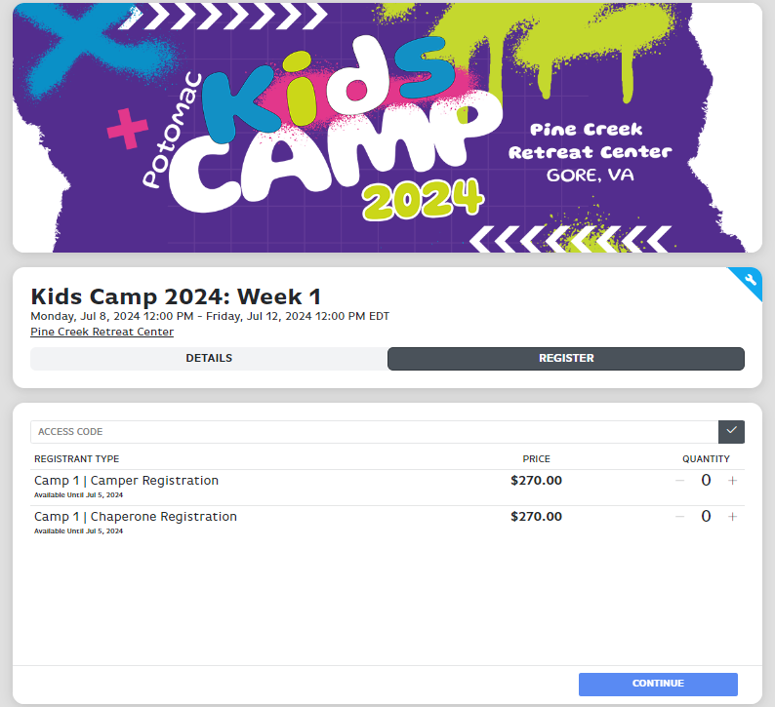
Notes:
When you get to this screen, you can see the week of camp you selected. Please notice the two tabs, Details and Register. On the Details tab is all the information we want you to know such as dates to remember and fees to take note of.
To proceed, click on the “Register” tab at the top of the screen.

Slide 3
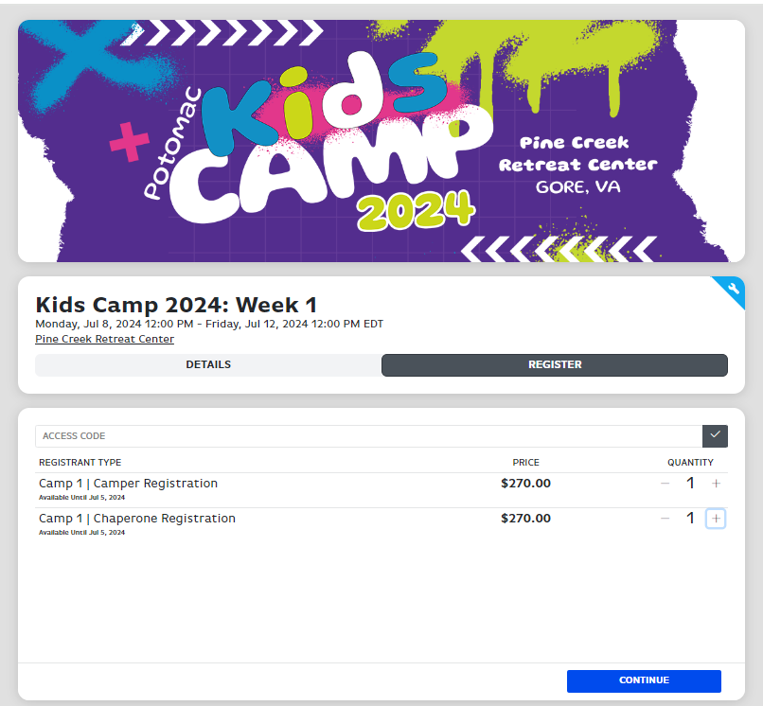
Notes:
On the Register tab, enter the number of total campers and chaperones who will be attending from your church. Then click the Continue button.

Slide 4
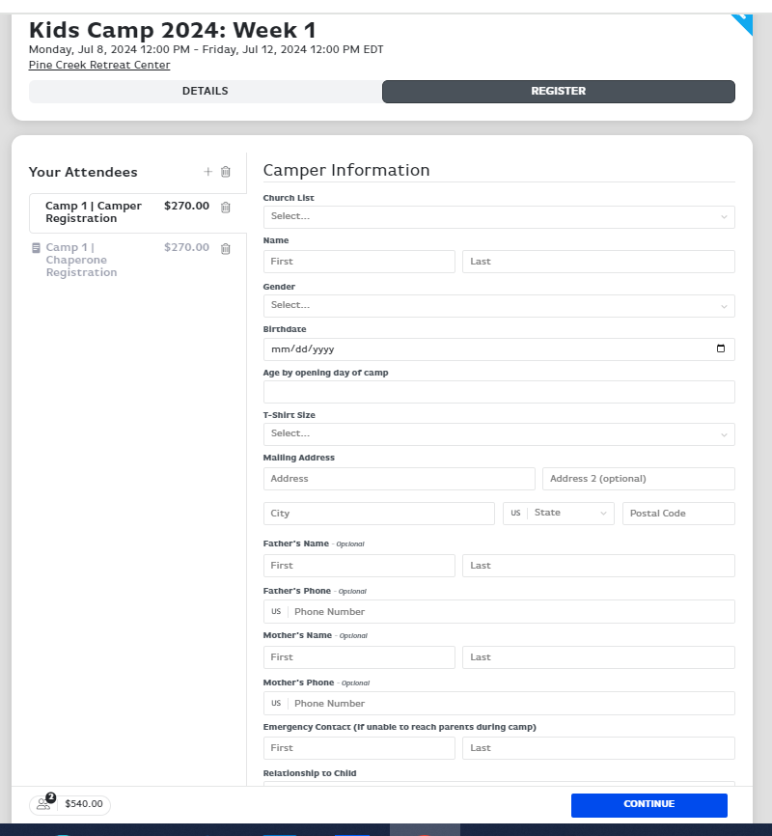
Notes:
Complete all the fields in the Camper Information area.

Slide 5
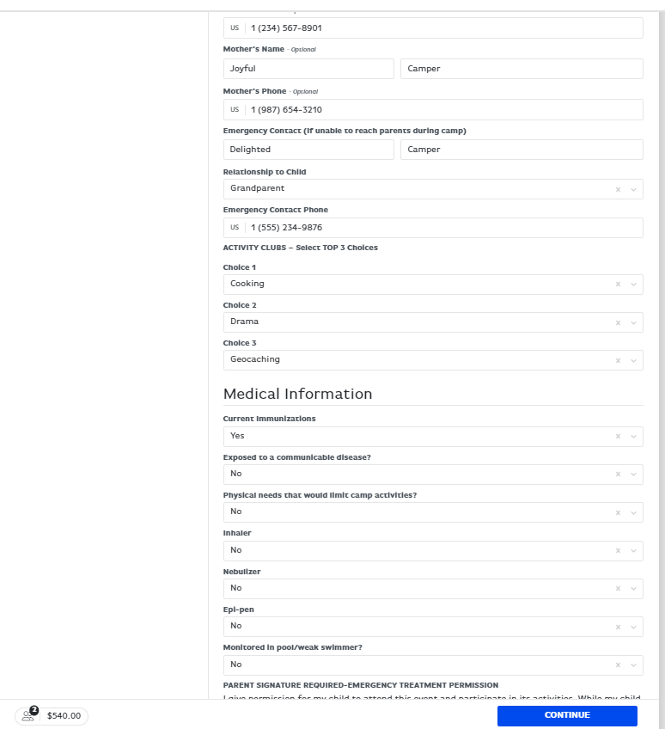
Notes:
Continue filling in all fields. This information is vital for us to be able to get in contact with a parent during camp should the need arise. You are also selecting your three club choices here. We will try our best to place everyone in the first or second of the three club choices they requested.

Slide 6
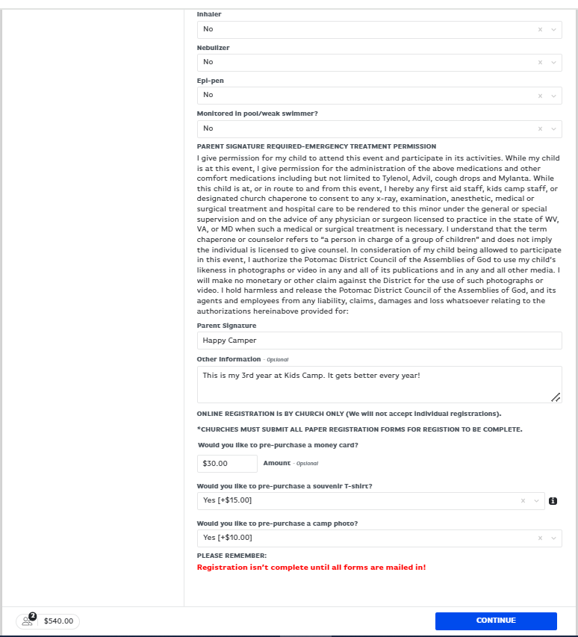
Notes:
In the Medical Information section, make sure to read the Emergency Treatment Permission and type the name of the parent in the Parent Signature block. Hit “Continue” button once all information has been entered and name is typed in Parent Signature box.

Slide 7
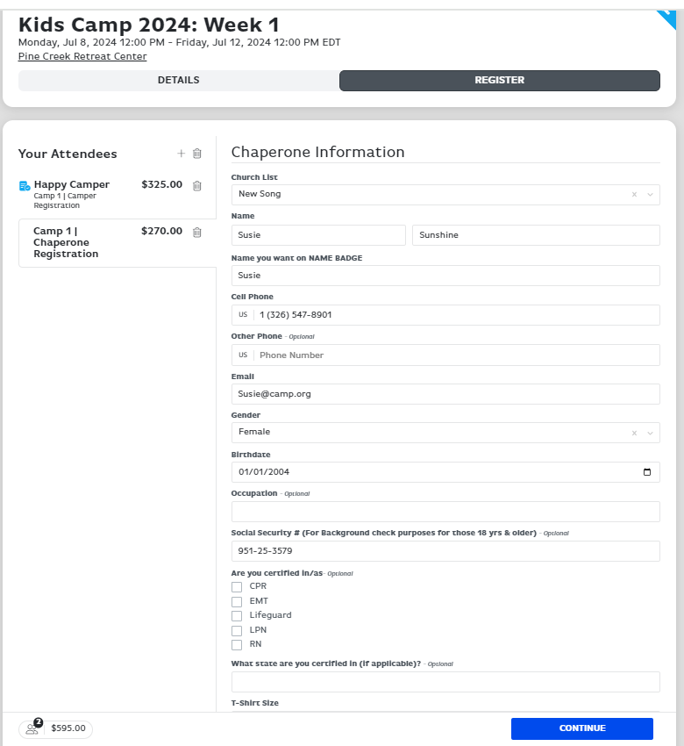
Notes:
Now enter all the information for the Chaperone(s) attending. If your church has not completed a background check within the last 4 years on the chaperone, make sure to include their Social Security number here. Also, please check all the boxes that apply for any area of certification for each chaperone.

Slide 8
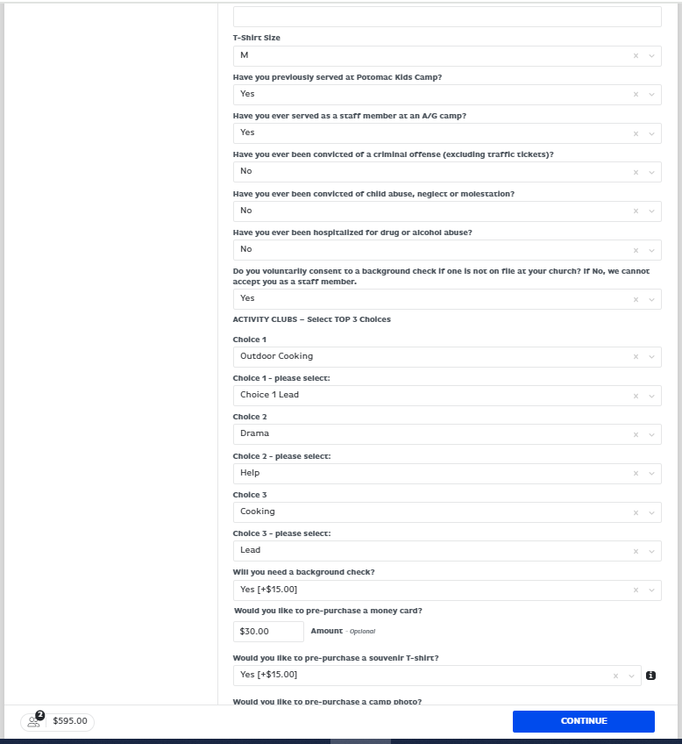
Notes:
Select three clubs you are willing to assist with. We do need leaders in each club to offer that club as an option for campers; so, please don’t be afraid to be a leader! Also, select “Yes” if a background check has not been completed by your church in the past four years, enter amount of money card desired, and if they would like a souvenir T-Shirt.

Slide 9
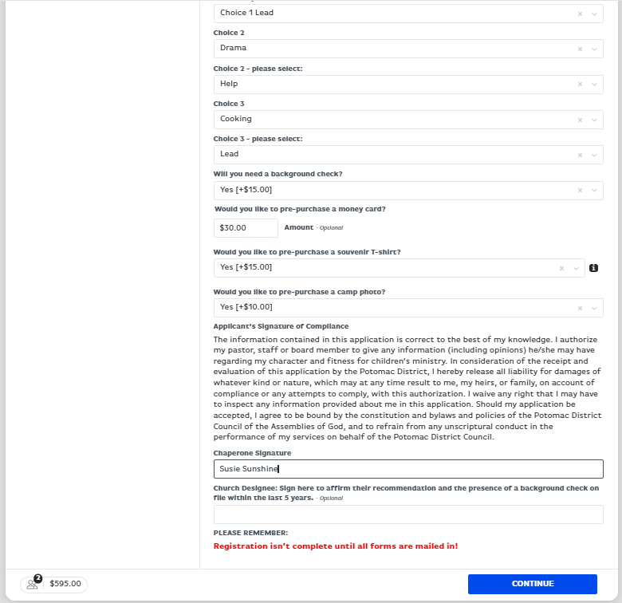
Notes:
Select “yes” if you would like a Group Church Photo and read the Applicant’s Signature of Compliance section and type the name of chaperone in the signature box. Then click “Continue”.

Slide 10
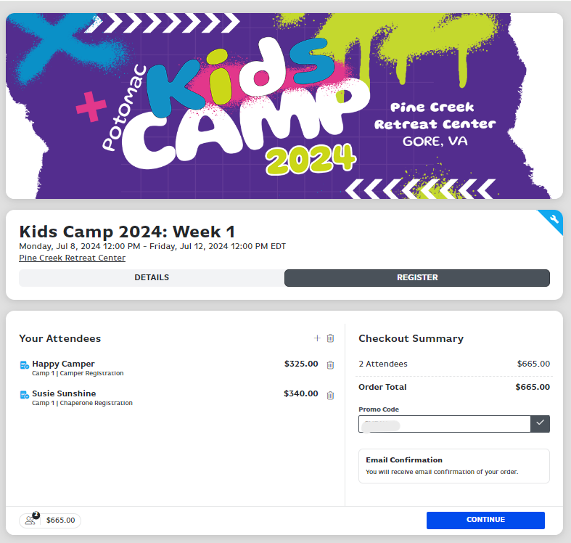
Notes:
This screen shows you the checkout summary. Once you verify the names of all your attendees have been submitted, click the “continue” button. If you would like to pay by check, please contact the Potomac Kids office to receive a promo code (Dorine at 571-297-2596 or Audrea at 703-753-2619) that should be entered in the box under Checkout Summary on the right before clicking the continue button.

Slide 11
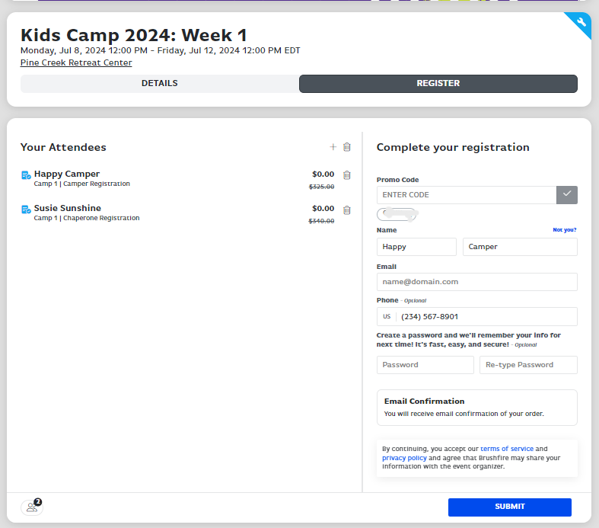
Notes:
Enter your email address and phone number so a confirmation of your order can be sent. Then click the “Submit” button.

Slide 12
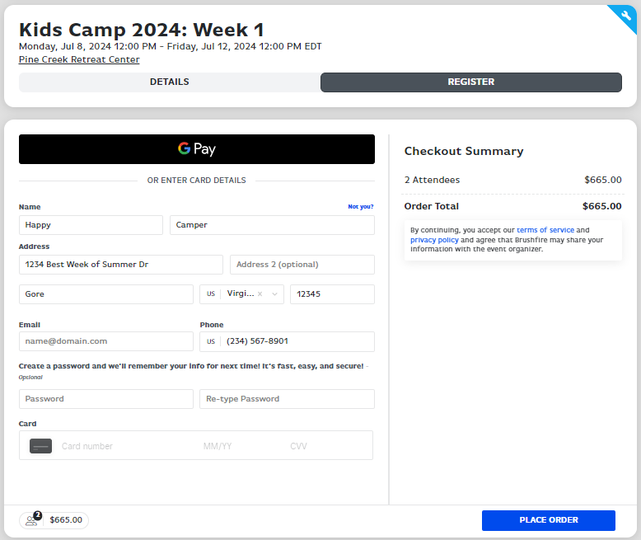
Notes:
If you are not paying by check, enter your credit card information here. Then click “Place Order” button.

Slide 13
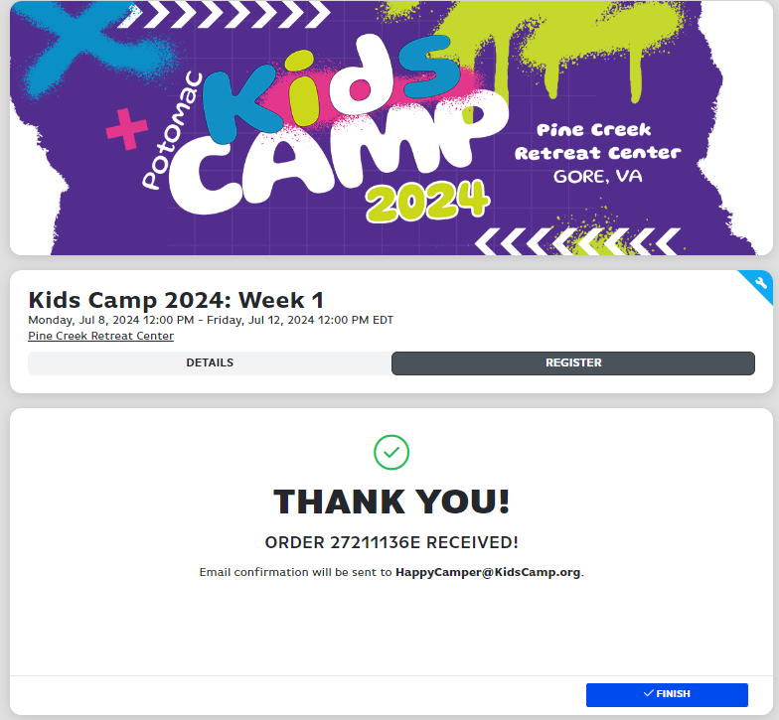
Notes:
Thank You! This completes the online registration process. If you have a problem while registering online, please call Dorine at 571-297-2596 or Audrea at 703-753-2619. We are looking forward to seeing you at camp this summer!!!!

